Slide 1
Planning, Implementing, and Evaluating Marketing Strategies
Chapter 2

Slide 2
Learning Objectives
LO 2-1 Explain the strategic planning process.
LO 2-2 Understand the importance of a firm’s mission statement and corporate and business-unit strategy.
LO 2-3 Discuss how analyzing organizational resources and the marketing environment can help identify opportunities and create competitive advantage.
LO 2-4 Explore how a firm develops marketing objectives and strategies that contribute to overall objectives.
LO 2-5 Identify what is necessary to manage the effective implementation of marketing strategies.
LO 2-6 Describe the four major elements of strategic performance evaluation.
LO 2-7 Outline the development of a marketing plan.

Slide 3
Strategic Marketing Management
Strategic marketing management – The process of planning, implementing, and evaluating the performance of marketing activities and strategies, both effectively and efficiently
  Effectiveness is the degree to which long-term customer relationships help achieve an organization’s objectives
  Efficiency refers to minimizing the resources an organization uses to achieve a specific level of desired customer relationships

Slide 4
The Strategic Planning Process
Strategic planning – The process of establishing an organizational mission and formulating goals, corporate strategy, marketing objectives, and a marketing strategy
  Should be guided by a market orientation to ensure that a concern for customer satisfaction is an integral part of the entire company, leading to the development of successful marketing strategies and planning processes

Slide 5
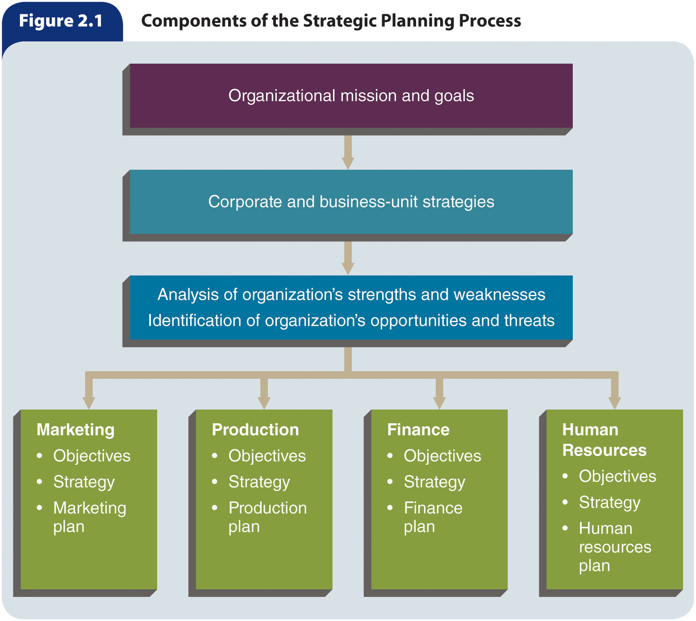
Figure 2.1 – Components of the Strategic Planning Process

Slide 6
Developing Organizational Mission and Goals
Mission statement – A long-term view, or vision, of what the organization wants to become
  The goals of any organization should derive from its mission statement
  An organization’s mission statement should answer two questions:
    Who are our customers?
    What is our core competency?
Companies try to develop and manage a consistent corporate identity—their unique symbols, personalities, and philosophies—to support all corporate activities, including strategic planning and marketing
An organization’s goals and objectives, derived from its mission statement, guide its planning efforts
  Goals focus on the end results the organization seeks

Slide 7
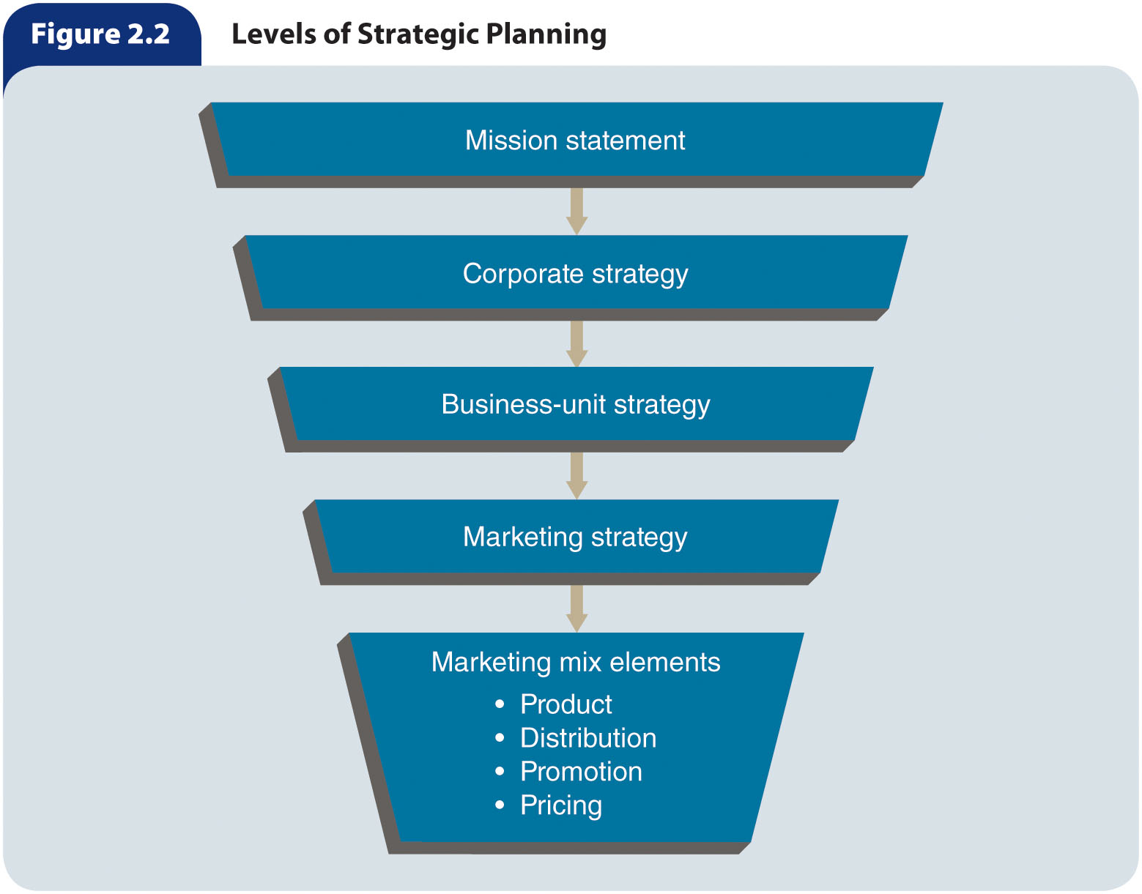
Figure 2.2 – Levels of Strategic Planning

Slide 8
Corporate Strategies
Corporate strategy – A strategy that determines the means for utilizing resources in the various functional areas to reach the organization’s goals
  Is the broadest of the three levels of strategy (corporate, business-unit, and marketing) and should be developed with the organization’s overall mission in mind
  Addresses the two questions posed in the organization’s mission statement:
    Who are our customers?
    What is our core competency?
Corporate strategy planners are concerned with broad issues such as:
  Organizational culture
  Competition
  Differentiation
  Diversification
  Interrelationships among business units
  Environmental and social issues
They attempt to match the resources of the organization with the opportunities and threats in the environment

Slide 9
Business-Unit Strategies (slide 1 of 3)
Business-unit strategy should be consistent with the corporate strategy while also serving the unit’s needs
  Strategic business unit (SBU) – A division, product line, or other profit center within the parent company
  Each of these units sell a distinct set of products to an identifiable group of customers and each competes with a well-defined set of competitors
  The revenues, costs, investments, and strategic plans of each SBU can be separated from those of the parent company and evaluated
Strategic planners should recognize the strategic performance capacities of each SBU and carefully allocate scarce resources among those divisions
  Market – A group of individuals and/or organizations that have needs for products in a product class and have the ability, willingness, and authority to purchase those products
  Market share – The percentage of a market that actually buys a specific product from a particular company

Slide 10
Business-Unit Strategies (slide 2 of 3)
Market growth/market share matrix – A helpful business tool, based on the philosophy that a product’s market growth rate and its market share are important considerations in determining its marketing strategy
  To develop such a tool, all of the company’s SBUs and products should be integrated into a single matrix and compared and evaluated to determine appropriate strategies for individual products and overall portfolio strategies
Stars are products with a dominant share of the market and good prospects for growth but use more cash than they generate to finance growth, add capacity, and increase market share
Cash cows have a dominant share of the market but low prospects for growth, and they typically generate more cash than is required to maintain market share
Dogs have a subordinate share of the market and low prospects for growth
Question marks have a small share of a growing market and generally require a large amount of cash to build market share

Slide 11
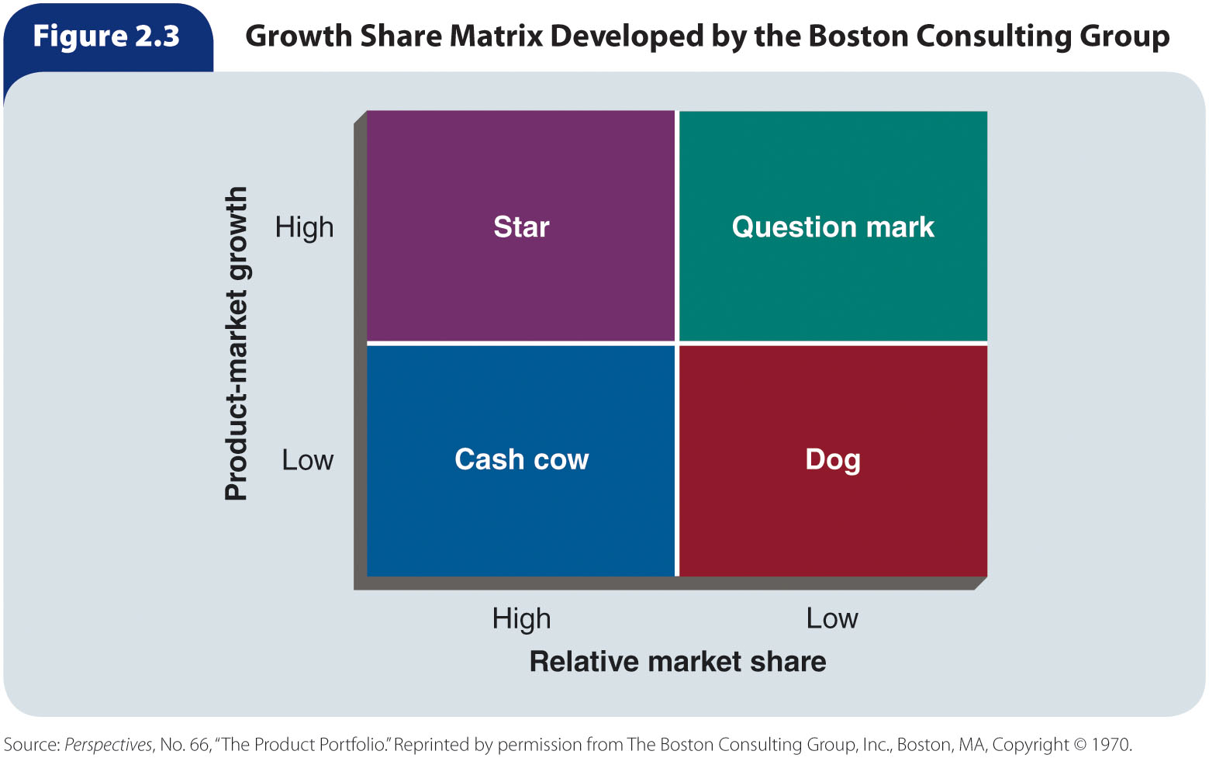
Figure 2.3 – Growth Share Matrix Developed by the Boston Consulting Group

Slide 12
Business-Unit Strategies (slide 3 of 3)
The long-term health of an organization depends on having some products that generate cash and others that use cash to support growth
The major indicators of a firm’s overall health are the:
  Size and vulnerability of the cash cows
  Prospects for the stars
  Number of question marks and dogs

Slide 13
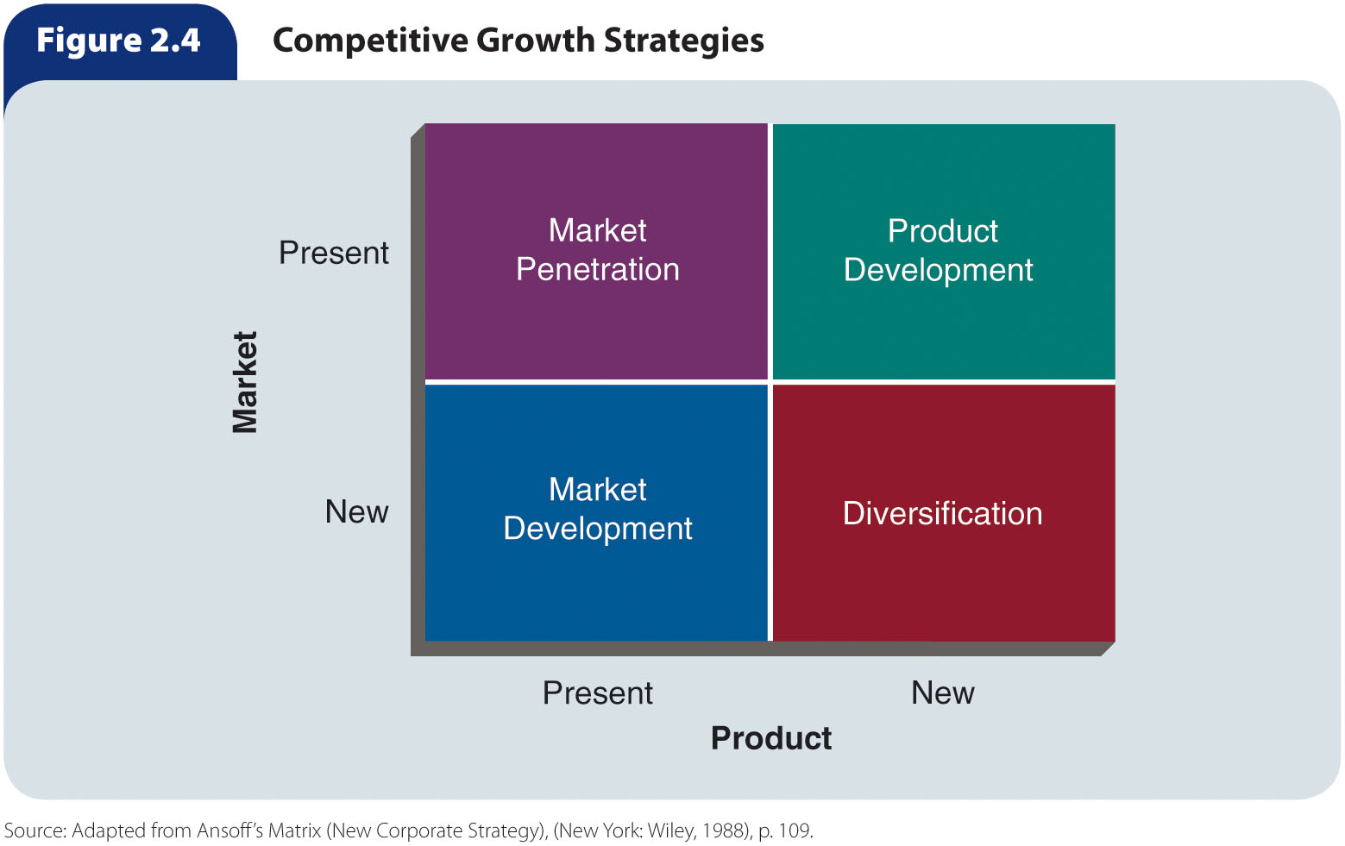
Figure 2.4 – Competitive Growth Strategies

Slide 14
Competitive Growth Strategies
Market penetration is a strategy of increasing sales in current markets with current products
Market development is a strategy of increasing sales of current products in new markets
Product development is a strategy of increasing sales by improving present products or developing new products for current markets
Diversification allows firms to make better and wider use of their managerial, technological, and financial resources

Slide 15
Assessing Organizational
Resources and Opportunities
The strategic planning process begins with an analysis of the marketing environment, including the industry in which the company operates or intends to sell its products
  Any strategic planning effort must take into account the organization’s available financial and human resources and capabilities and how these resources are likely to change over time
Core competencies – Things a company does extremely well, which sometimes give it an advantage over its competition
Market opportunity – A combination of circumstances and timing that permits an organization to take action to reach a particular target market
Strategic windows – Temporary periods of optimal fit between the key requirements of a market and the particular capabilities of a company competing in that market
Competitive advantage – The result of a company matching a core competency to opportunities it has discovered in the marketplace

Slide 16
SWOT Analysis
SWOT analysis – Assessment of an organization’s strengths, weaknesses, opportunities, and threats
  Strengths and weaknesses are internal factors that can influence an organization’s ability to satisfy its target market
  Opportunities and threats affect all organizations within an industry, market, or geographic region because they exist outside of and independently of the company
Strengths – Competitive advantages, or core competencies, that give the company an advantage
Weaknesses – Limitations a company faces in developing or implementing a marketing strategy
Opportunities – Favorable conditions in the environment that could produce rewards for the organization if acted upon
Threats – Barriers that could prevent the company from reaching its objectives

Slide 17
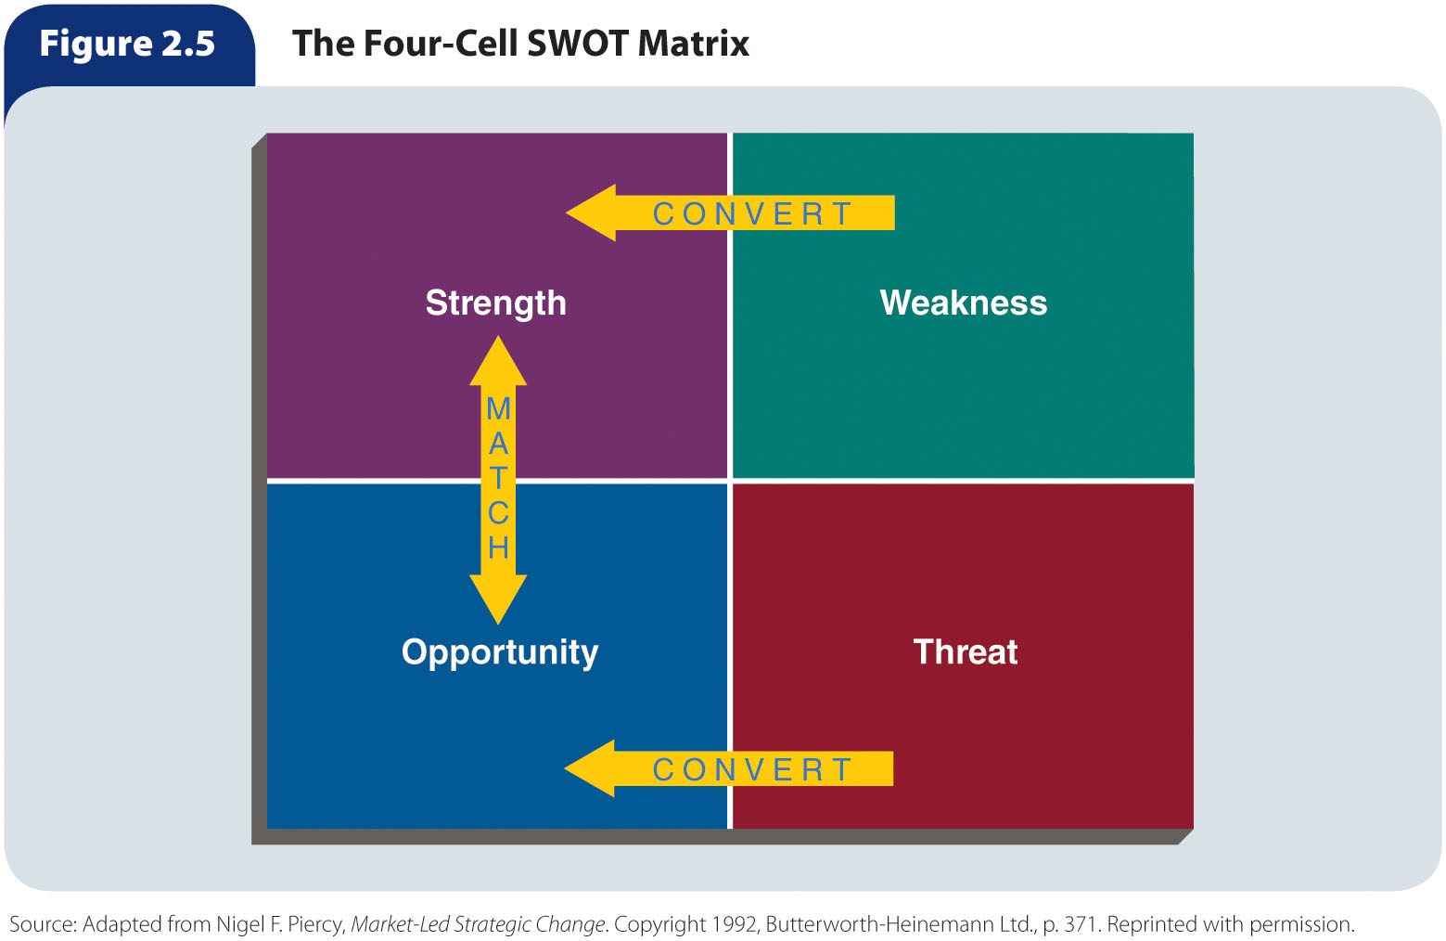
Figure 2.5 – The Four-Cell
SWOT Matrix

Slide 18
First-Mover and Late-Mover Advantage (slide 1 of 2)
First-mover advantage – The ability of an innovative company to achieve long-term competitive advantages by being the first to offer a certain product in the marketplace
  Helps a company build a reputation as a pioneer and market leader
  The market is free of competition
  Helps establish customer brand loyalty in cases when switching to another brand later may be costly or difficult
  The firm can protect its trade secrets and technology through patents
Risks of being the first to enter a market:
  There are usually high cost outlays associated with created a new product, including costs of:
    Market research
    Product development
    Production
    Marketing or buyer education
  Early sales growth may not match predictions if the firm overestimates demand or fails to target marketing efforts correctly
  The company runs the risk that the product will fail due to market uncertainty, or that the product might not completely meet consumers’ expectations or needs

Slide 19
First-Mover and Late-Mover Advantage (slide 2 of 2)
Late-mover advantage – The ability of later market entrants to achieve long-term competitive advantages by not being the first to offer a certain product in a marketplace
  Can benefit from the first mover’s mistakes and have a chance to improve on the product design and marketing strategy
  Is likely to have lower initial investment costs than the first mover because the first mover has already developed a distribution infrastructure and educated buyers about the product
  There is more data and certainty about product success
Disadvantages of being a late mover:
  The first mover may have patents and other protections on its technology and trade secrets that prevent the late mover from producing a similar product
  Customers who have already purchased the first mover’s product may believe that switching to the late mover’s product will be expensive or time-consuming, thus making it difficult for the late mover to gain market share
  The timing of entry into the market is crucial and can determine the amount of late-mover advantage that is actually possible

Slide 20
Developing Marketing Objectives and Marketing Strategies
Marketing objective – A statement of what is to be accomplished through marketing activities
  Should:
    Be based on a careful study of the SWOT analysis
    Match strengths to opportunities
    Eliminate weaknesses
    Minimize threats
    Be stated in clear, simple terms
    Be measurable
    Specify a time for its accomplishment
    Be consistent with business-unit and corporate strategies
Marketing strategy – A plan of action for identifying and analyzing a target market and developing a marketing mix to meet the needs of that market

Slide 21
Selecting the Target Market
Selecting an appropriate target market may be the most important decision a company makes in the strategic planning process
  Identification and analysis of a target market provide a foundation on which a company can develop a marketing mix
  Marketers should also assess whether the company has the appropriate resources to develop a marketing mix that meets the needs of a particular target market

Slide 22
Creating the Marketing Mixes
Using all relevant information available to conduct in-depth research allows a firm to select the most appropriate target market, which is the basis for creating a marketing mix that satisfies the needs of that market
An organization should analyze demographic information, customer needs, preferences, and behaviors with respect to product design, pricing, distribution, and promotion
All marketing mix decisions should be:
  Consistent with the business-unit and corporate strategies
  Flexible to permit the organization to alter the marketing mix in response to changes in market conditions, competition, and customer needs
Utilizing the marketing mix as a tool set, a company can detail how it will achieve a competitive advantage
  Sustainable competitive advantage – An advantage that the competition cannot copy
  How can an organization make its competitive
  advantage sustainable over time?

Slide 23
Managing Marketing Implementation
Marketing implementation – The process of putting marketing strategies into action
  The effective implementation of any and all marketing activities depends on a well-organized marketing department that is capable of:
    Motivating personnel
    Communicating effectively
    Employing good coordination efforts
    Setting reasonable and attainable timetables for activity completion

Slide 24
Organizing the Marketing Unit
Companies that truly adopt the marketing concept develop an organizational culture that is based on a shared set of beliefs that places the customer’s needs at the center of decisions about strategy and operations
Centralized organization – A structure in which top-level managers delegate little authority to lower levels
Decentralized organization – A structure in which decision-making authority is delegated as far down the chain of command as possible

Slide 25
Coordinating and Communicating (slide 1 of 2)
Marketing managers must coordinate diverse employee actions to achieve marketing objectives and work closely with other departments to ensure that marketing activities align with other functions of the firm
  Must coordinate the activities of internal marketing staff with the marketing efforts of external organizations
  Managers can improve coordination by making each employee aware of how his or her job relates to others and how his or her actions contribute to the achievement of marketing objectives
It is important that communication flow up, from the front lines of the organization to upper management
  In this way, marketing managers can gain access to a rich source of information about:
    What customers require
    How products are selling
    The effectiveness of marketing activities
    Any issues with marketing implementation

Slide 26
Coordinating and Communicating (slide 2 of 2)
Training is an essential element of communicating with marketing employees
  An effective training program provides employees with a forum to learn and ask questions, and results in employees who are empowered and can be held accountable for their performance
To motivate marketing personnel, managers must address their employees’ needs to maintain a high level of workplace satisfaction
Employee motivation and reward programs should be fair, ethical, and well understood
A firm can motivate its employees through a variety of methods, including by:
  Linking pay with performance
  Informing workers how their performance affects department and corporate results and their own compensation
  Providing appropriate and competitive compensation
  Implementing a flexible benefits program
  Adopting a participative management approach

Slide 27
Establishing a Timetable for Implementation
Establishing an implementation timetable involves several steps:
  Identifying the activities to be performed
  Determining the time required to complete each activity
  Separating the activities to be performed in sequence from those to be performed simultaneously
  Organizing the activities in the proper order
  Assigning responsibility for completing each activity to one or more employees, teams, or managers

Slide 28
Evaluating Marketing Strategies
Strategic performance evaluation – Establishing performance standards, measuring actual performance, comparing actual performance with established standards, and modifying the marketing strategy, if needed

Slide 29
Establishing Performance Standards
Performance standard – An expected level of performance against which actual performance can be compared
  For example, a 20 percent reduction in customer complaints, a monthly sales quota of $150,000, or a 10 percent increase in new-customer accounts
  Performance standards are derived from marketing objectives that are set while developing the marketing strategy

Slide 30
Analyzing Actual Performance
The principal means by which a marketer can gauge whether a marketing strategy has been effective in achieving objectives is by analyzing the actual performance of the marketing strategy

Slide 31
Sales Analysis
Sales analysis – Analysis of sales figures to evaluate a firm’s performance
  It is a common method of evaluation because sales data are readily available and can reflect the target market’s reactions to a marketing mix
  Current sales data must be compared with forecasted sales, industry sales, specific competitor’s sales, and the costs incurred from marketing efforts to achieve the sales volume
Although sales may be measured in several ways, the basic unit of measurement is the sales transaction
  Organizations should record all information related to a transaction so that they can analyze sales in terms of dollar volume or market share
    Firms frequently use dollar volume in their sales analyses because the dollar is a common denominator of sales, costs, and profits
      A marketing manager who uses dollar-volume analysis should factor out the effects of price changes, which can show the numbers by making it seem that more or fewer sales have been made than is the actual case
    A firm’s market share is the firm’s sales of a product stated as a percentage of industry sales of competing products
      The primary reason for using market share analysis is to estimate whether sales changes have resulted from the firm’s marketing strategy or from uncontrollable environmental forces

Slide 32
Marketing Cost Analysis
Marketing cost analysis – Analysis of costs to determine which are associated with specific marketing efforts
  One way to analyze costs is by comparing a company’s costs with industry averages
    When looking at industry averages, a company should take into account its own unique situation
    The company’s costs can differ from the industry average for several reasons, including its own marketing objectives, cost structure, geographic location, types of customers, and scale of operations

Slide 33
Comparing Actual Performance with Performance Standards and Making Changes, If Needed
When actual performance exceeds performance standards:
  Try to gain an understanding of why a marketing strategy is effective
When actual performance does not meet performance standards:
  Determine why a marketing strategy was less effective than expected
  Determine whether the marketing objective, against which performance is measured, is realistic or not

Slide 34
Creating the Marketing Plan
Marketing plan – A written document that specifies the activities to be performed to implement and control the organization’s marketing strategies
  A clear and well-written marketing plan:
    Provides a uniform marketing vision for the firm and is the basis for internal communications
    Delineates marketing responsibilities tasks and outlines schedule for implementation
    Presents objectives and specifies how resources are to be allocated to achieve them
    Helps marketing managers monitor and evaluate the performance of a marketing strategy
  Organizations should make sure that the marketing plan aligns with corporate and business-unit strategies and is accessible to and shared with all key employees

Slide 35
Table 2.1 – Components of the
Marketing Plan (1 of 2)
Plan Component | Component Summary | Highlights
Executive Summary | One- to two-page synopsis of the entire marketing plan | 1. Stress key points 2. Include one to three key points that make the company unique
Environmental Analysis | Information about the company’s current situation with respect to the marketing environment | 1. Assess marketing environment factors 2. Assess target market(s) 3. Assess current marketing objectives and performance
SWOT Analysis | Assessment of the organization’s strengths, weaknesses, opportunities, and threats | 1. Company strengths 2. Company weaknesses 3. Opportunities in the environment and industry 4. Threats in the environment and industry

Slide 36
Table 2.1 – Components of the
Marketing Plan (2 of 2)
Plan Component | Component Summary | Highlights
Marketing Objectives | Specification of the company’s marketing objectives | 1. Qualitative measures of what is to be accomplished 2. Quantitative measures of what is to be accomplished
Marketing Strategies | Outline of how the company will achieve its objectives | 1. Target market(s) 2. Marketing mix
Marketing Implementation | Outline of how the company will implement its marketing strategies | 1. Marketing organization 2. Activities and responsibilities 3. Implementation timetable
Performance Evaluation | Explanation of how the company will evaluate the performance of the implemented plan | 1. Performance standards 2. Financial controls 3. Monitoring procedures (audits)

